Slide 1
Time Consumption analysis
Team member: Vishnu S
Vishal. J
Reshma .R
Mentor Name :DR.g.Sai krishnan

Slide 2
Problem Statement
The Goal is to identify where the Time wastage happening in the service and using best possible way to stop the Consumption and optimize the time .
With the Data from the center and with the help of the Data Analysis to identify the time Consumption in the car service

Slide 3
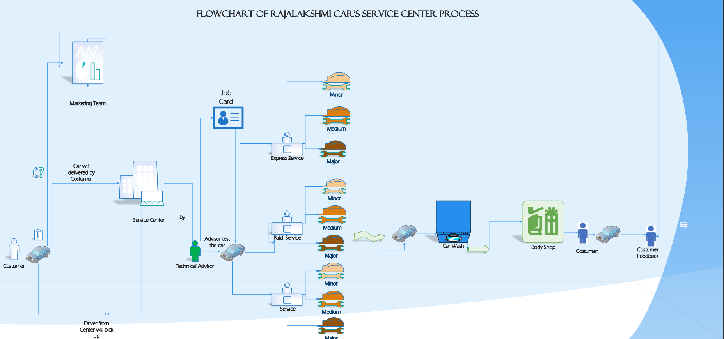
Flowchart

Slide 4
Findings
According to our analysis on the data where 34% of time consumed by 77 Car of five types Car Model and remaining time 66% was utilized by 575 car of remaining 29 car model types .
In that 34 % of car where almost 72% of cars under the PMS(Period maintenance Service ) which are 59 cars and remaining 28% of cars under the RR (Running Fault).
75% of cars which comes for almost serviced and processed within a day or below. Around 53 % Service are Periodic Maintenance service indicates better service in the Center.
There are certain model in the service which are BALENO , CELERIO , NEW ERTIGA , NEW SWIFT ,SWIFT , SCROSS , WAGON R , SWIFT DZIRE consumes 34% of the Total Service time.
According to dataset where Periodic Maintenance Service around 53% , Running Fault around 19% , Free Service FR1 around 9% and FR2 around 10% and FR3 around 6%.

Slide 5
Recommendation
With the help of the Findings from the analysis , we found that only Certain model type car cause the Time Delay and Time Consumption in the Service processing.
1.One of our best choice of solution is to provide the Special training and Educating the employee in those Certain model types which mentioned before to optimize the solution .
2.By increasing the manpower in the Periodic Maintenance Service might reduce the time because the PMS is the most using Service and potential one of the service which consumes more time too.
3. Using the Warehouse Management Software(WMS) to help in the Organize and administrator the part in the warehouse .

Slide 6
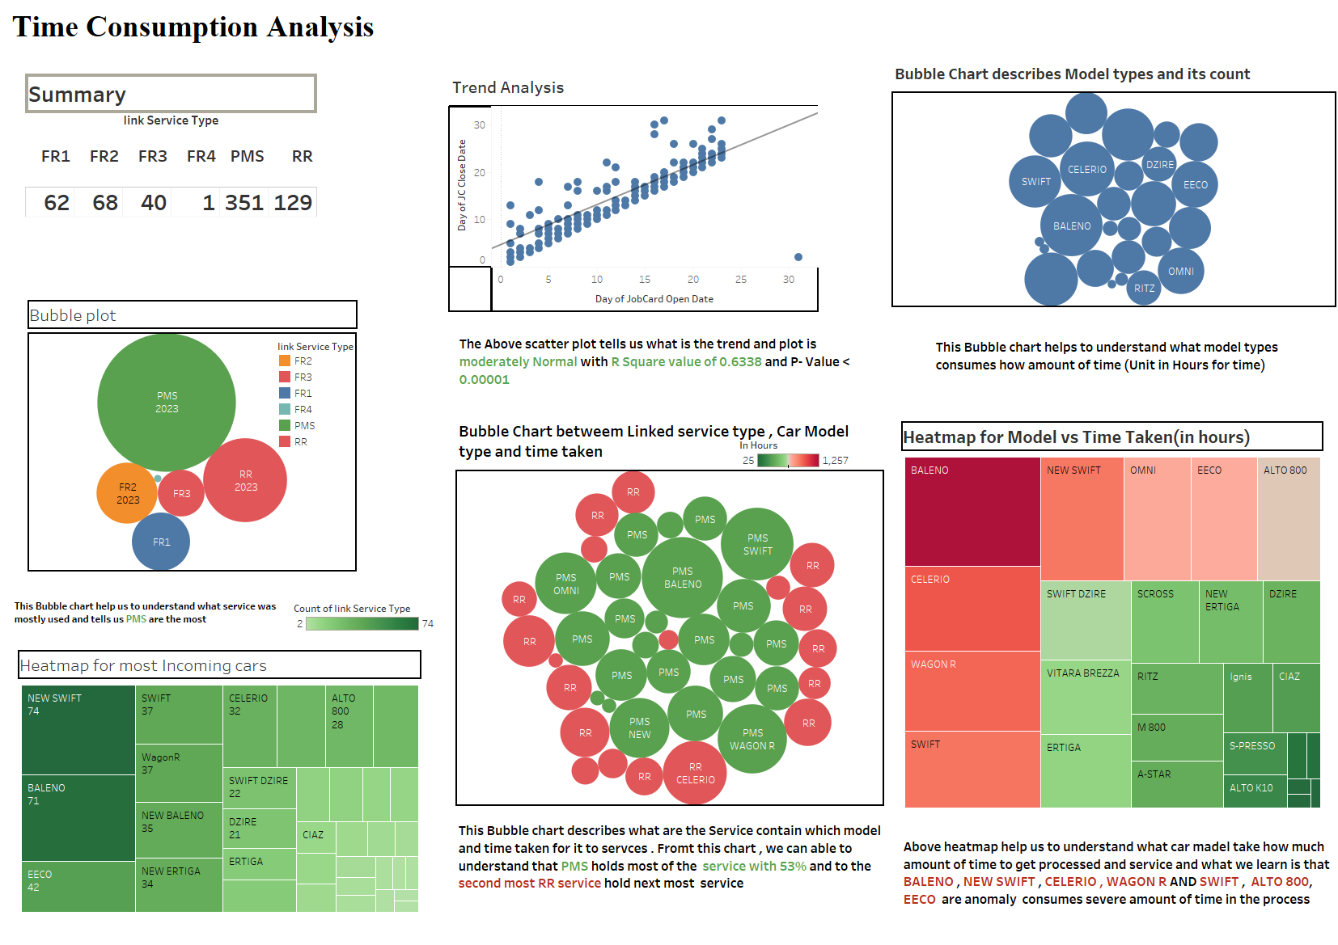

Slide 7
Conclusion
With the help Data Analysis and Data Visualization using Tableau to find the Time Consumption in the Service Process where identified and which helps to optimize the time of the Car service .
Educating and Training the Employee in the area where the Time Consumption might be the best method to optimize the Service Time
In Future, Using the Machine learning model to predicate and forecast where problem in the Service Management by feeding the data will simplify everything .

